Slide 1
From Model to Production
An Automated MLOps Pipeline for Fraud Detection
By Brandyn Ewanek 9216750

Slide 2

The Fraud Problem
Problem:
The government agency's manual processes to detection fraud are failing because they are not able to manage the volume.
Concerns:
Distributions of certain features have changed over time. (Data Drift)
Believe that relation between features and fraud have changed ( Concept Drift)
Need a system to always be live, no down time.
Wants to ensure high rate of detection of fraud cases

Slide 3
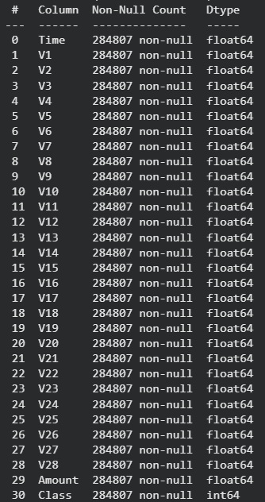
The Data: Anonymized & Imbalanced
Source: Kaggle's Credit Card Fraud Dataset.
Scale: 284,807 transactions over two days, with 31 columns.
Anonymization: To protect citizen privacy, the 28 primary features (V1-V28) are Principal Components (PCA), meaning the original data is hidden. This was a key "government agency" requirement.
Features: We are left with 30 continuous features (the anonymized V1-V28, plus Time and Amount) and one binary target.
Target: Class is our binary target: 1 for Fraud, 0 for Normal.
Key Challenge: Extreme Class Imbalance: The dataset is highly unbalanced. Only 492 transactions are fraudulent (0.172%), which makes detection very difficult.

Slide 4
Conceptual Architecture
S3 Data Lake
Stores all raw data, processed files, and model artifacts, acting as the pipeline's single source of truth .
EventBridge Trigger
The "Scheduled Trigger". This rule automatically runs the SageMaker Pipeline on the first of every "month" to ensure regular, planned retraining.
SageMaker Pipeline
The core MLOps "factory". It automates our Python scripts (preprocess, train, evaluate) into a single, orchestrated workflow to build a new model .
Model Registry
Acts as the central "model library". It versions each newly trained model and tracks its "Approved" or "Rejected" status based on performance metrics .
CI/CD Trigger
The "Continuous Deployment" (CD) trigger. An EventBridge rule detects when a new model is set to "Approved" in the registry, which then triggers an AWS Lambda function to deploy it
SageMaker Endpoint
The production RESTful API. The agency's application sends new data here and receives a live fraud probability score in real-time .
Model Monitor
The "Drift Trigger" . It captures live API data, detects data drift by comparing it to the training baseline , and fires an alarm to trigger a new pipeline run, completing the MLOps loop.

Slide 5
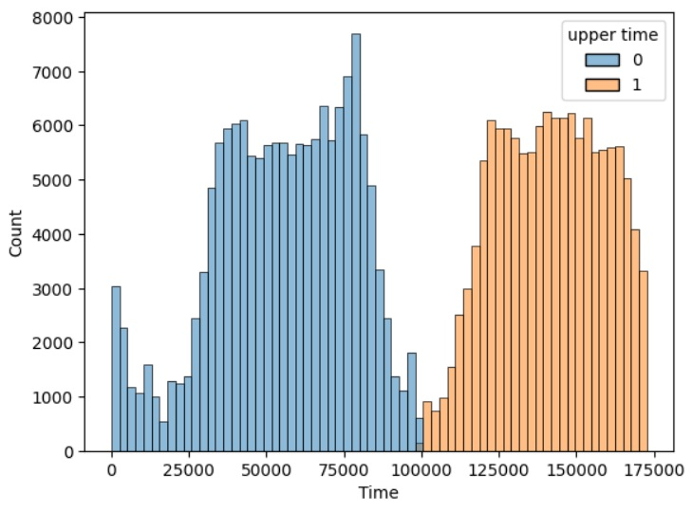
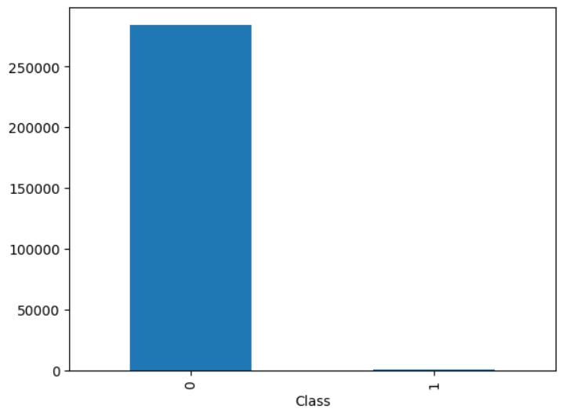
Preprocessing
Binning Time - This feature is bimodal, which potentially represents two distinct relationships with target. The choice was made to create a ‘upper time’ binary feature.
Train Test Split - Advance models have an ability to ‘map’ detailed patterns between features however some of the patterns will be random non-repeating. To ensure our model is ready for production we will reserve 30% for testing, simulating real world performance.
Smote - A common problem with Fraud predictions is the large imbalance. To fix this we will be upsampling class ‘1’. So that our model doesn’t only learn to predict class ‘0’.
Standardize - To ensure our model doesn’t let the scale of different features impact its selection of features potentially skew the model we will standardize the features. Using standard scaling but taking mean and std from train data.

Slide 6
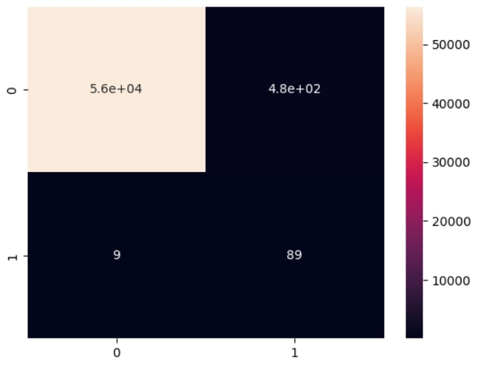
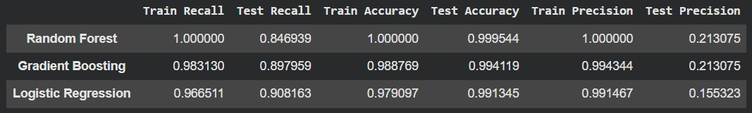
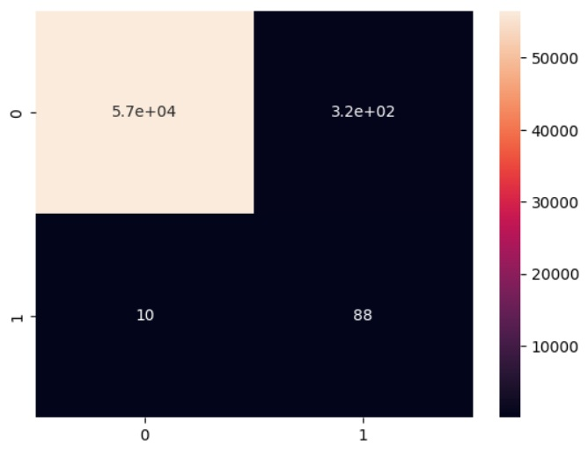
Modeling Initial Experiments
Logistic Regression
Gradient Boosting
In the initial phase of model development we used the default setting to build the initial pipeline and in future we will further enhance models.
Tested RandomForest, GradientBoosting, and LogisticBagging models. Recall represents the % of the target class the model was able to find in the dataset, precision represents that total % target class predictions correction.
For this system recall will be the metric of interest. This is because we are trying to detect as many fraud cases as possible and the over prediction of class 0 will have a margin cost to it.
With type I errors being low real world Cost Logistic Regression inside Bagging Ensemble will be our model of choice.

Slide 7
Complete Modeling Workflow
Phase 1: Event
The workflow begins when a new monthly data file is uploaded to a specific folder in your Amazon S3 bucket
Phase 2: MLOPs Pipeline
Amazon SageMaker Pipeline
Preprocesses the data, store train and test data.
Trains new model with new data.
Compares New Model with Old.
Load best model to model registry
Phase 3: Continuous Pipeline
Model Registry - sees new model approved
Triggers Event Bridge to run Lambda function.
Lambda function deploys new model to endpoint.
Phase 4: Production and Monitoring
SageMaker Endpoint (the API) is now serving live predictions
Model Monitor compares new data with old.
If drift detected triggers Pipeline.

Slide 8
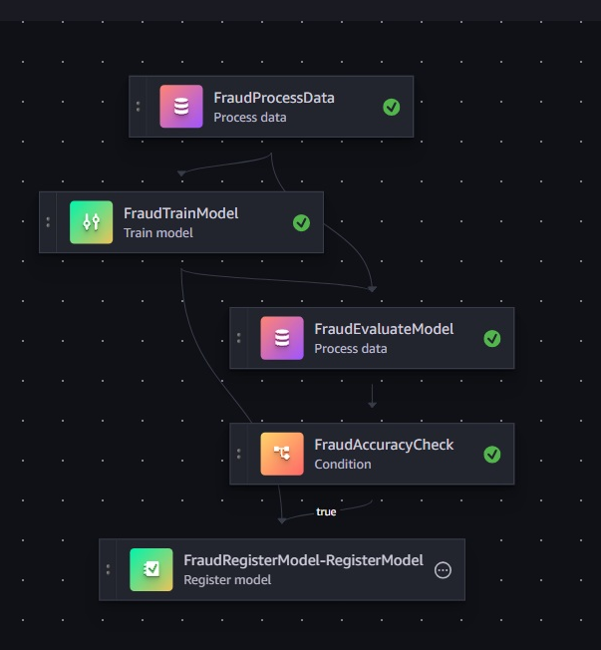
The Automated MLOps Pipeline Steps
Data Processing (FraudProcessData) Automates feature engineering and splits the raw creditcard.csv into training and testing datasets using a SageMaker Processing Job.
Model Training (FraudTrainModel) Trains a Logistic Regression model on the processed data, automatically applying SMOTE to fix the class imbalance issues.
Model Evaluation (FraudEvaluateModel) Runs the trained model against the unseen test set to generate a "report card" of metrics (Recall, F1-Score) saved as a JSON file.
Quality Gate (FraudAccuracyCheck) A conditional logic step that checks the evaluation report. It only registers the model if the F1-Score is above your threshold (0.60), ensuring bad models never reach production.

Slide 9
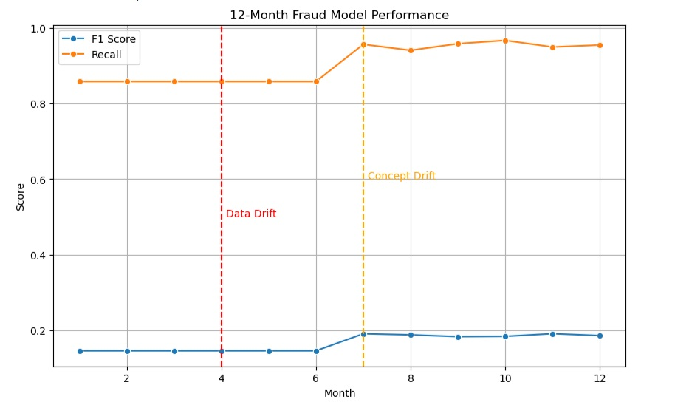
Detecting Drift 12 Month Simulation
Pipeline Steps
Data Processing: Automated feature selection and train/test splitting.
Model Training: Trained Logistic Regression using SMOTE to fix class imbalance.
Evaluation: Calculated performance metrics (Recall, F1-Score) on unseen data.
Quality Gate: Conditional logic that only registers models if Recall > 0.60 and better than previous model.
Drift
Months 1 - 3 baseline,
Months 4 to 6 We progressively shifted the mean of feature V1 by adding a small drift factor (0.1, 0.2, 0.3).
Months 7 to 12 We introduced a new rule: High-value transactions (top 5% by amount) that were previously "Normal" were flipped to "Fraud" at a rate of 10%.

Slide 10
Key Challenges & Solutions (Permissions vs. Environment)
Challenge 1: Root User vs. IAM User Conflict
Symptom: The Unknown IAM PrincipalArn: ...:root error when trying to create a project.
Solution: The system was trying to use my Root login. I had to create a new browser profile (or use Incognito) to force a clean login as my brandyn IAM user.
Challenge 2: The "Invalid Security Token" Error
Symptom: The red error bar (Failed to fetch git connections...) and the JupyterLab "gray screen".
Solution: This looked like a permission error but was a browser cookie policy. As confirmed by support, SageMaker requires third-party cookies to connect the console to the notebook domain. The fix was to "Allow cookies" for the SageMaker site in my Incognito browser.
Challenge 3: "Hanging Cell" & Incomplete Startup
Symptom: The notebook would open, but a simple !pip install would take 20+ minutes and fail. Running a cell (like import pandas) would hang indefinitely, and the "stop" button wouldn't work.
Solution: After confirming all permissions were correct, AWS Support helped identify the root cause: the SageMaker Domain was in VPC only mode without the necessary VPC endpoints.
Challenge 4: "Dependency Hell" Breaking S3 Access
Symptom: The notebook failed to load data with a cryptic NoneType can't be used in 'await' expression error, even though IAM permissions were perfect.
Root Cause: Installing awscli triggered an automatic upgrade of botocore (to v1.41.3), which broke the aiobotocore library that Pandas uses for S3 connections.
Solution: We identified the version conflict and modified the environment setup to exclude awscli (which is pre-installed), restoring the compatible dependency chain.

Slide 11
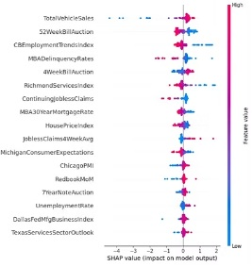
Next Steps
Further model experimentation
We spent little time on this to focus on establishing a working CI/CD pipeline. With this complete we can return to the model and further enhance its predictive ability further increase the agency’s profit margins.
Deep Analysis of Deep Cases
Using Amazon Athena or Sagemaker Studio we could employ a deep analysis of fraud cases potentially identify valuable information that could be used to prevent the cases before hitting our AWS endpoint.
Shaply values would be valuable in determining
the effect the features have on target.
Learning that when feature V2 is high we see high
chances of fraud could be valuable to the
fraud prevention team.

Slide 12
Appendix.
Coding Submission Folder.

